Slide 1
Optimizing Bank Marketing Performance
Data-Driven Strategies for Targeted Customer Acquisition & Conversion Footer: Prepared by Joel Olusanya | 14 August, 2026

Slide 2
Executive Summary (The Bottom Line Up Front )
Action Title: Targeted marketing interventions can significantly reduce acquisition waste. Content (3 Columns / Tiles)
1. Identify the Core Driver: Conversion is heavily concentrated in specific age cohorts rather than evenly distributed.
2. Optimize Channels: Campaign timing and channel selection directly influence customer response rates.
3. Strategic Pivot: Reallocating 30% of budget to high-yield segments increases expected return on ad spend (ROAS).

Slide 3

Current Performance & Bottlenecks (The Problem)
Action Title: Broad campaigns suffer from high acquisition friction and low conversion visibility.
Mass blanket calling resulted in high marketing costs.
Lack of audience segmentation led to wasted phone calls on low-intent clients.
Difficulty tracking real-time success metrics during previous cycles.

Slide 4
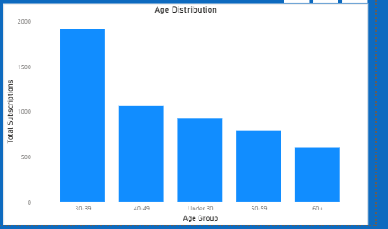
Demographic Breakdown – The Power of Targeting
Action Title: Customer conversion rates peak sharply within specific age groups.
Younger and older demographics exhibit drastically different propensity to subscribe.

Slide 5
Strategic Recommendations and Next Steps
Action Title: A phased reallocation of marketing resources will maximize campaign ROI.
3-Step Tiled Flow / Timeline:
Phase 1 (Immediate): Pause low-performing demographic segments and reallocate budget to top-tier cohorts.
Phase 2 (Q2): Personalize messaging triggers based on historical engagement patterns.
Phase 3 (Q3): Implement automated tracking dashboards for real-time campaign adjustments.

